Slide 1








PROBLEM STATEMENT EDUCATION EQUITY In many urban areas, low-income groups have limited access to quality education, leading to persistent economic inequality
Mentored By: Dr.K.Vijay Chandra
Addressing Educational Inequality in Urban Low-Income Communities
WA-1
1. VAMSHI – 23071A05H0 – CSE C
2. HIMANADH-23071A05A0-IT
3. JISHNU-23071A05C9-IT
Mentored By:
Dr.K.Vijay Chandra
Centre for Presencing & Design Thinking
VNRVJIET

Slide 2
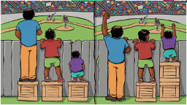
PROBLEM STATEMENT: In many urban areas, low-income groups have limited access to quality education, leading to persistent economic inequality
Explanation:
Quality education is a critical component in breaking the cycle of poverty and promoting economic mobility. However, in many urban areas, low-income groups often face significant barriers in accessing the resources and opportunities needed to succeed academically.

Slide 3






Understanding the EducationGap
Achievement Gaps
College
Enrollment
01
02
Low-income students often lag behind their higher-income peers in academic performance and standardized test scores.
College enrollment and
completion rates are
substantially lower for
students from low-income communities.

Slide 4
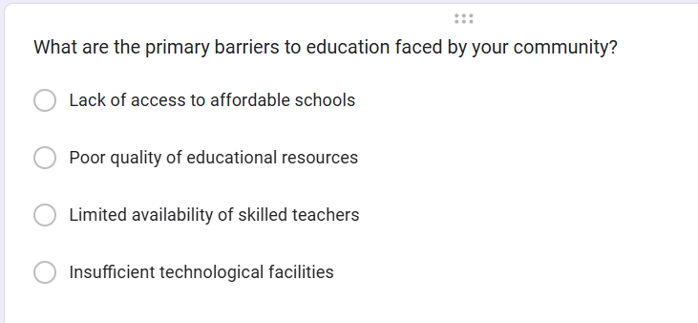
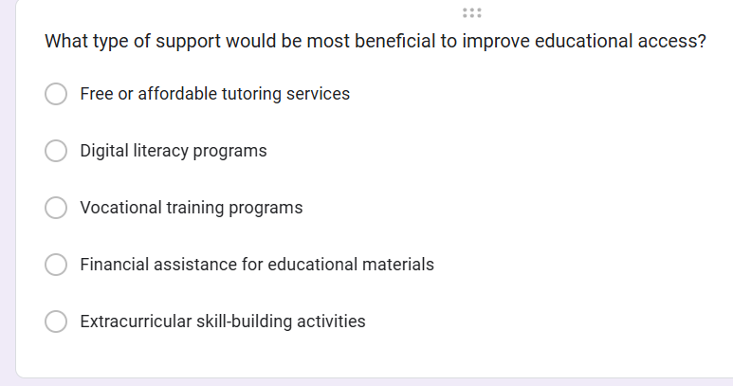
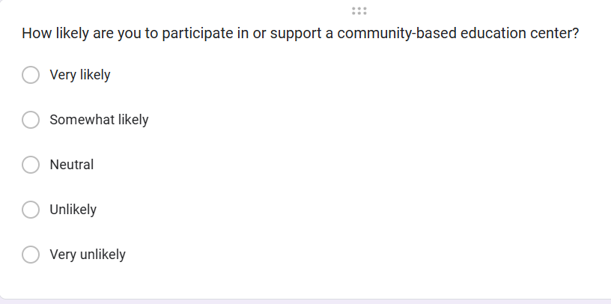
QUESTIONS ASKED IN SURVEY FORM

Slide 5
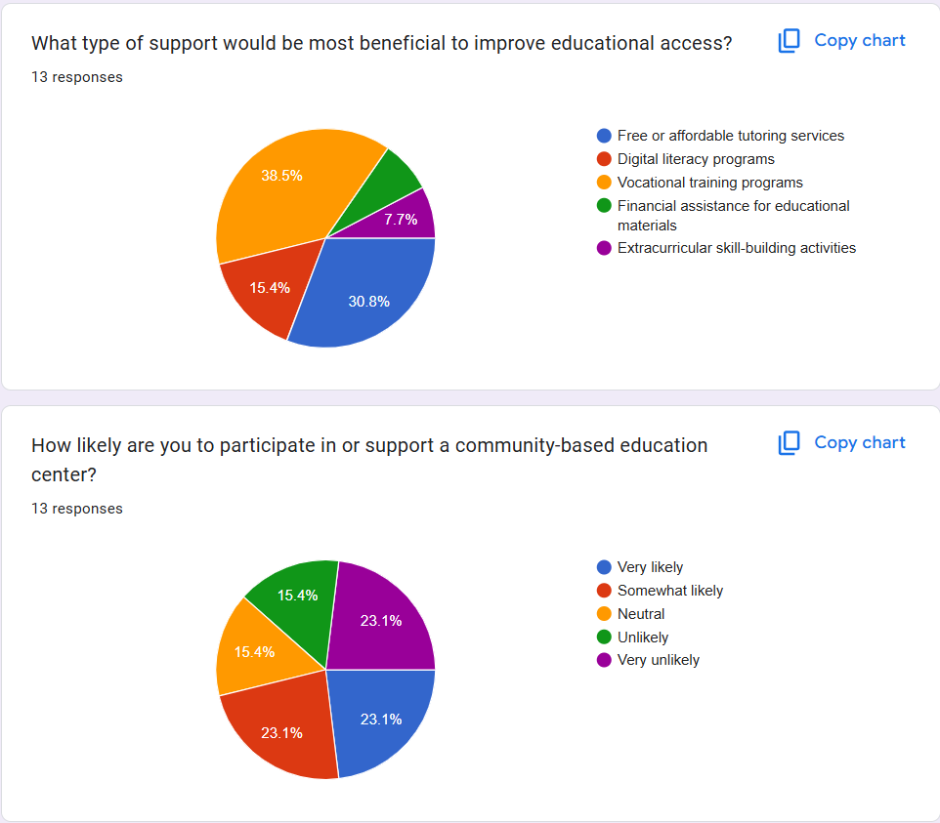
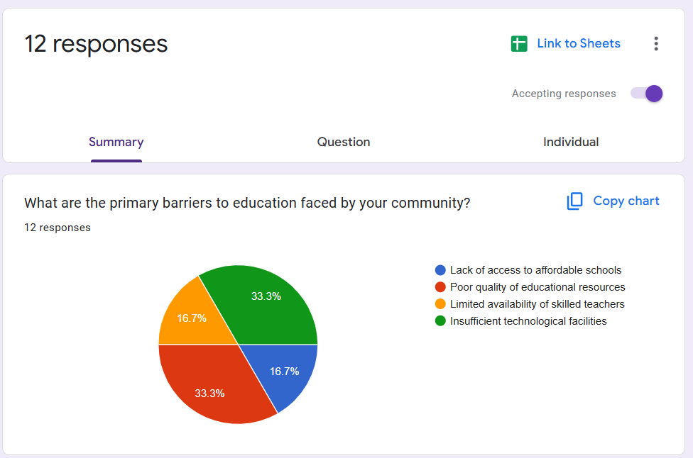
STATISTICS FROM GRAPH
43 RESPONSES

Slide 6
Empathy Tools Used To Address The Problem
A
B
C
Create journey maps for students, parents, and teachers, detailing their daily routines, touchpoints, challenges, and emotions.
Conduct one-on-one interviews and small focus groups with students, parents, and educators.
Walk with students or parents in their community to understand physical access barriers
Interviews and Focus Groups
Journey Mapping
Community Walk-Alongs

Slide 7

INSIGHTS
PRIMARY NEEDS
Infrastructure
Establish physical locations for community-based education centers.
Ensure facilities include classrooms, computer labs, and accessible utilities.
Technology
Computers, internet access, and digital tools for learning.
Educational software for digital literacy and skill-building.
Faculty and Staff
Skilled teachers for academic subjects.
Trainers for vocational and technical programs.Mentors for personal development
Curriculum and Resources
Customized curriculum for tutoring, digital literacy, and vocational training.
Educational materials such as books, workbooks, and multimedia resources.

Slide 8
INSIGHTS
SECONDARY NEEDS
Extracurricular Activities
Arts, sports, and cultural programs to foster creativity and teamwork.
Clubs for debate, coding, or other interests to enhance engagement.
Parent and Community Involvement
Workshops for parents on the importance of education and support strategies.
Community events to build relationships and encourage participation.
Awareness Campaigns
Promoting the importance of education through local campaigns and social media.
Reaching out to underserved communities to increase enrollment.

Slide 9
INSIGHTS
LATENT NEEDS
Advanced Skill Development
Offer specialized courses in trending fields like AI, coding , etc;
Programs to bridge the gap between basic education and advanced careers.
Collaboration with Tech Giants
Partnerships with companies like Google, Microsoft, or local tech startups for resources, workshops, and certifications.

Slide 10
TYPES OF USERS
MAINSTREAM USERS
Parents from Low-Income Families:
Concerned about the quality of education their children receive.
Interested in affordable tutoring and skill-building programs.
Look for safe and trustworthy community initiatives.
Youth and Adults Seeking Skills:
Individuals aiming to improve their employability through digital literacy or vocational training.
Value practical skills that can lead to immediate job opportunities or income generation.

Slide 11
LEADSTREAM USERS
Early Adopters of New Educational Initiatives:
Actively seek solutions to bridge educational gaps in their community.
Willing to experiment with new teaching and learning methods.
Community Advocates and Influencers:
Respected figures who can rally others to participate in the program.
Often serve as the voice for underserved groups.

Slide 12
EXSTREAM USERS
Highly Disadvantaged Individuals:
Children or adults with no access to formal education due to severe poverty or marginalized status.
May include individuals from homeless families or minority groups facing discrimination.
Overachievers from Low-Income Groups:
Exceptionally motivated individuals striving for excellence despite limited resources.
Often self-learners or those who seek out any available opportunities for education.

Slide 13
IDEATION METHOD-SCAMPER
Collaborative Techniques
Purpose: Leverage group creativity and teamwork.
Brainstorming: Open sharing of ideas without judgment.
Mind Mapping: Visualizing connections between concepts.
Affinity Diagrams: Grouping related ideas for deeper insights.
Round Robin: Each participant contributes one idea in turn.
Co-Design: Engaging stakeholders in the ideation process.

Slide 14
IDEATION METHOD-SCAMPER
2. Analytical Techniques
Purpose: Structured and logical approaches to ideation.
SWOT Analysis: Assessing strengths, weaknesses, opportunities, and threats.
SCAMPER: Substituting, Combining, Adapting, Modifying, Putting to other use, Eliminating, and Rearranging.
Reverse Engineering: Breaking down existing solutions to inspire new ones.
Lotus Blossom: Expanding a central idea into sub-ideas.
Root Cause Analysis: Identifying fundamental problems to develop solutions.

Slide 15


Iterating
Address User Pain Points:Your project addresses key pain points by providing essential education information, offering career guidance and mentorship, and helping students find financial aid. It also fosters a supportive community. This empowers students to achieve their educational and career goals..
Expand Content Based on Needs
Enhance Accessibility
Enhance Accessibility: simillarly for enhanced accesabilityYour project enhances accessibility by providing critical education information, offering personalized career guidance and mentorship, and aiding in financial aid navigation. It also creates an inclusive community. These features empower all students to reach their educational and career aspirations.
Continuous Engagement
Address User Pain Points

Slide 16

Planning and research
Testing and Launch
Conduct thorough research to understand the needs of your target audience. Define project goals, identify stakeholders, and create a detailed project plan with timelines, resources, and milestones.
test the website for functionality and usability. Gather feedback from a small group of users, make necessary adjustments, finalize content, and prepare a launch plan
B
A
Design and Development
Content Creation and Integration
Design the website's layout and user interface, create wireframes, and develop the site. Ensure it is user-friendly and accessible, integrating all necessary features like career guidance tools and mentorship platforms.
D
C
Create and curate engaging content such as success stories, career advice articles, and videos. Collaborate with experts for high-quality talks and webinars, and integrate all content into the website.

Slide 17
TEAM EXPERIENCES
The Power of Collaboration We came together as individuals from diverse backgrounds, but our shared goal of addressing educational inequality united us. Brainstorming sessions turned into moments of creative breakthroughs, where every idea—big or small—was valued and built upon.
Walking in Their Shoes Empathy became our compass. Through heartfelt conversations with students, parents, and educators, and walking the streets of underserved communities, we experienced their challenges firsthand. These moments transformed our perspective and deepened our commitment.
Facing the Challenges, Together The road wasn’t always smooth. Balancing differing viewpoints, limited resources, and ambitious goals tested us. But each hurdle strengthened our resolve and taught us the art of finding solutions through perseverance.

Slide 18
THANK YOU

